Slide 1
Unit 4 BNF and Syntax Diagrams

Slide 2
Backus-Naur form and variants
Metasyntax: a syntax used to describe the syntax of languages,
BNF (Backus–Naur Form) is a metasyntax used to express context free grammars
BNF is widely used as a notation for the grammars programming languages, instruction sets, communication protocols and parts of natural language grammars

Slide 3
Backus-Naur form and variants (cont)
A set of rules is specified. These are known as production rules.
Each production rule defines the pattern that represents a named structured part of the language
The name of such a part is called a non-terminal symbol in the language.
The basic elements of the language are called terminal symbols.

Slide 4
Backus-Naur form and variants (cont)
Each rule contains the name of the non-terminal being defined, followed by the sequence or alternative sequences allowed for that symbol. A defining sequence can contain any terminal and non-terminal symbols allowed for that language.
The definition of a rule can also contain the symbol being defined by that rules. This is called recursive definition.

Slide 5
Example: Grammar for Arithmetic Expressions
Productions
<Exp> ::=
“+”<Expr2>|”-”<Expr2>|<Expr2>
<Expr2> ::= <Term><Expr3>
<Expr3> ::= “+” <Term><Expr3>|
”-”<Term><Expr3>|ε
<Term> ::= <Factor> <Term2>
<Term2> ::= “*” <Factor> <Term2> |”/”<Factor> <Term2>|ε
<Factor> ::=“ident”|”number”|”(“<Exp>”)”
Terminal symbols
simple TS: "+", "-", "*", "/", "(", ")"
terminal classes: “ident”, “number”
Nonterminal symbols
<Expr>, <Expr2>, <Expr3>, <Term>, <Term2>, <Factor>
Start symbol
<Expr>

Slide 6
EBNF(Extended BNF)
Terminal symbols start with lower-case letters
Nonterminal symbols start with upper-case letters
Metasymbols
| (...) separates alternatives groups
[...] alternatives optional part
{...} iterative part

Slide 7
KPL Grammar in BNF
01) Prog ::= KW_PROGRAM Ident SB_SEMICOLON Block SB_PERIOD
02) Block ::= KW_CONST ConstDecl ConstDecls Block2
03) Block ::= Block2
04) Block2 ::= KW_TYPE TypeDecl TypeDecls Block3
05) Block2 ::= Block3
06) Block3 ::= KW_VAR VarDecl VarDecls Block4
07) Block3 ::= Block4
08) Block4 ::= SubDecls Block5
09) Block5 ::= KW_BEGIN Statements KW_END
Notes:
7

Slide 8
KPL Grammar in BNF
10) ConstDecls::= ConstDecl ConstDecls
11) ConstDecls::= ε
12) ConstDecl ::= Ident SB_EQUAL Constant SB_SEMICOLON
13) TypeDecls ::= TypeDecl TypeDecls
14) TypeDecls ::= ε
15) TypeDecl ::= Ident SB_EQUAL Type SB_SEMICOLON
16) VarDecls ::= VarDecl VarDecls
17) VarDecls ::= ε
18) VarDecl ::= Ident SB_COLON Type SB_SEMICOLON
19) SubDecls ::= FunDecl SubDecls
20) SubDecls ::= ProcDecl SubDecls
21) SubDecls ::= ε
Notes:
8

Slide 9
KPL Grammar in BNF
22) FunDecl ::= KW_FUNCTION Ident Params SB_COLON BasicType
SB_SEMICOLON Block SB_SEMICOLON
23) ProcDecl ::= KW_PROCEDURE Ident Params SB_SEMICOLON Block
SB_SEMICOLON
24) Params ::= SB_LPAR Param Params2 SB_RPAR
25) Params ::= ε
26) Params2 ::= SB_SEMICOLON Param Params2
27) Params2 ::= ε
28) Param ::= Ident SB_COLON BasicType
29) Param ::= KW_VAR Ident SB_COLON BasicType
Notes:
9

Slide 10
KPL Grammar in BNF
30) Type ::= KW_INTEGER
31) Type ::= KW_CHAR
32) Type ::= TypeIdent
33) Type ::= KW_ARRAY SB_LSEL Number SB_RSEL KW_OF Type
34) BasicType ::= KW_INTEGER
35) BasicType ::= KW_CHAR
36) UnsignedConstant ::= Number
37) UnsignedConstant ::= ConstIdent
38) UnsignedConstant ::= ConstChar
40) Constant ::= SB_PLUS Constant2
41) Constant ::= SB_MINUS Constant2
42) Constant ::= Constant2
43) Constant ::= ConstChar
44) Constant2::= ConstIdent
45) Constant2::= Number
Notes:
10

Slide 11
KPL Grammar in BNF
46) Statements ::= Statement Statements2
47) Statements2 ::= KW_SEMICOLON Statement Statements2
48) Statements2 ::= ε
49) Statement ::= AssignSt
50) Statement ::= CallSt
51) Statement ::= GroupSt
52) Statement ::= IfSt
53) Statement ::= WhileSt
54) Statement ::= ForSt
55) Statement ::= ε
Notes:
11

Slide 12
KPL Grammar in BNF
56) AssignSt ::= Variable SB_ASSIGN Expession
57) AssignSt ::= FunctionIdent SB_ASSIGN Expression
58) CallSt ::= KW_CALL ProcedureIdent Arguments
59) GroupSt ::= KW_BEGIN Statements KW_END
60) IfSt ::= KW_IF Condition KW_THEN Statement ElseSt
61) ElseSt ::= KW_ELSE Statement
62) ElseSt ::= ε
63) WhileSt ::= KW_WHILE Condition KW_DO Statement
64) ForSt ::= KW_FOR VariableIdent SB_ASSIGN Expression
KW_TO Expression KW_DO Statement
Notes:
12

Slide 13
KPL Grammar in BNF
65) Arguments ::= SB_LPAR Expression Arguments2 SB_RPAR
66) Arguments ::= ε
67) Arguments2::= SB_COMMA Expression Arguments2
68) Arguments2::= ε
68) Condition ::= Expression Condition2
69) Condition2::= SB_EQ Expression
70) Condition2::= SB_NEQ Expression
71) Condition2::= SB_LE Expression
72) Condition2::= SB_LT Expression
73) Condition2::= SB_GE Expression
74) Condition2::= SB_GT Expression
Notes:
13

Slide 14
KPL Grammar in BNF
75) Expression ::= SB_PLUS Expression2
76) Expression ::= SB_MINUS Expression2
77) Expression ::= Expression2
78) Expression2 ::= Term Expression3
79) Expression3 ::= SB_PLUS Term Expression3
80) Expression3 ::= SB_MINUS Term Expression3
81) Expression3 ::= ε
82) Term ::= Factor Term2
83) Term2 ::= SB_TIMES Factor Term2
84) Term2 ::= SB_SLASH Factor Term2
85) Term2 ::= ε
Notes:
14

Slide 15
KPL Grammar in BNF
86) Factor ::= UnsignedConstant
87) Factor ::= Variable
88) Factor ::= FunctionApplication
89) Factor ::= SB_LPAR Expression SB_RPAR
90) Variable ::= VariableIdent Indexes
91) FunctionApplication ::= FunctionIdent Arguments
92) Indexes ::= SB_LSEL Expression SB_RSEL Indexes
93) Indexes ::= ε
Notes:
15

Slide 16
Syntax Diagram
Each diagram defines a non-terminal
There is a main diagram which defines the language
Each diagram has an entry point and an end point
Terminals are represented by round boxes
Nonterminals are represented by square boxes.

Slide 17
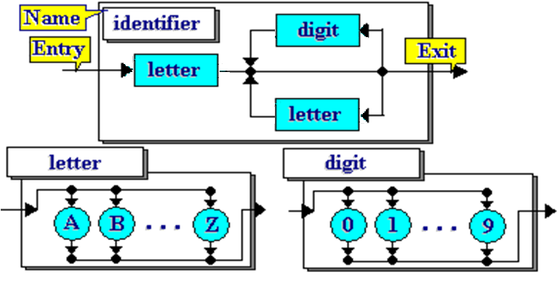
Examples of syntax diagram

Slide 18
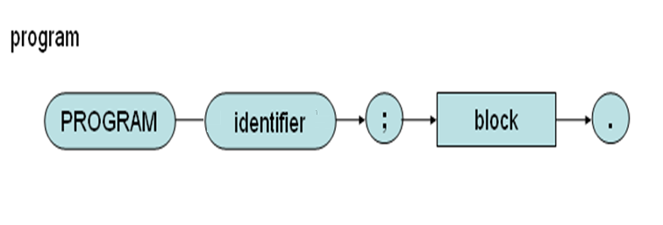
Syntax Diagrams of KPL (program)

Slide 19
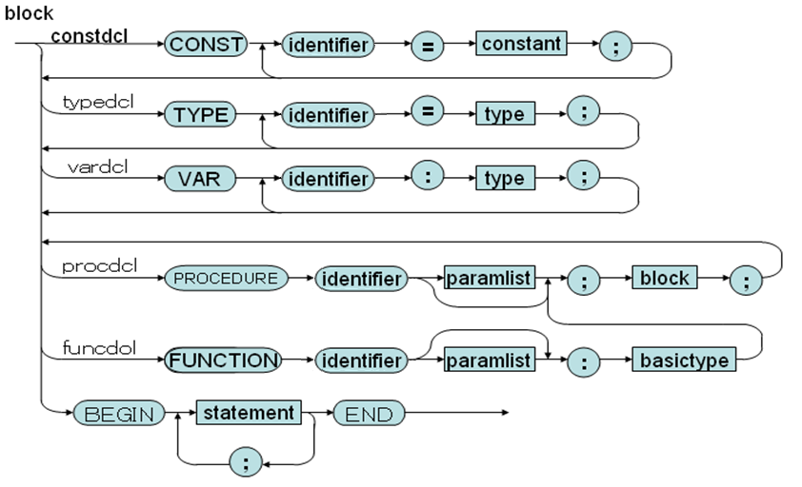
Syntax Diagrams of KPL(block)

Slide 20
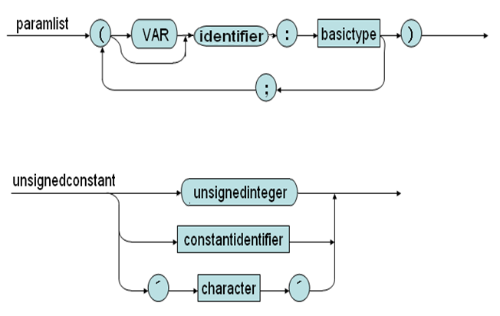
Syntax Diagrams of KPL (list of parameters, unsigned constant)

Slide 21
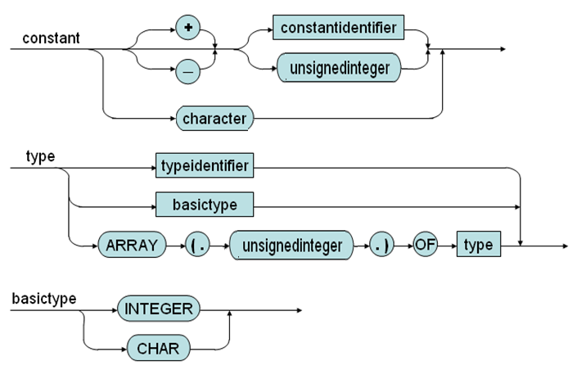
Syntax Diagrams of KPL (declarations)

Slide 22
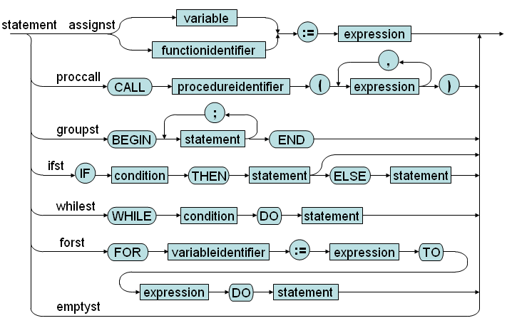
Syntax Diagrams of KPL (statement)

Slide 23
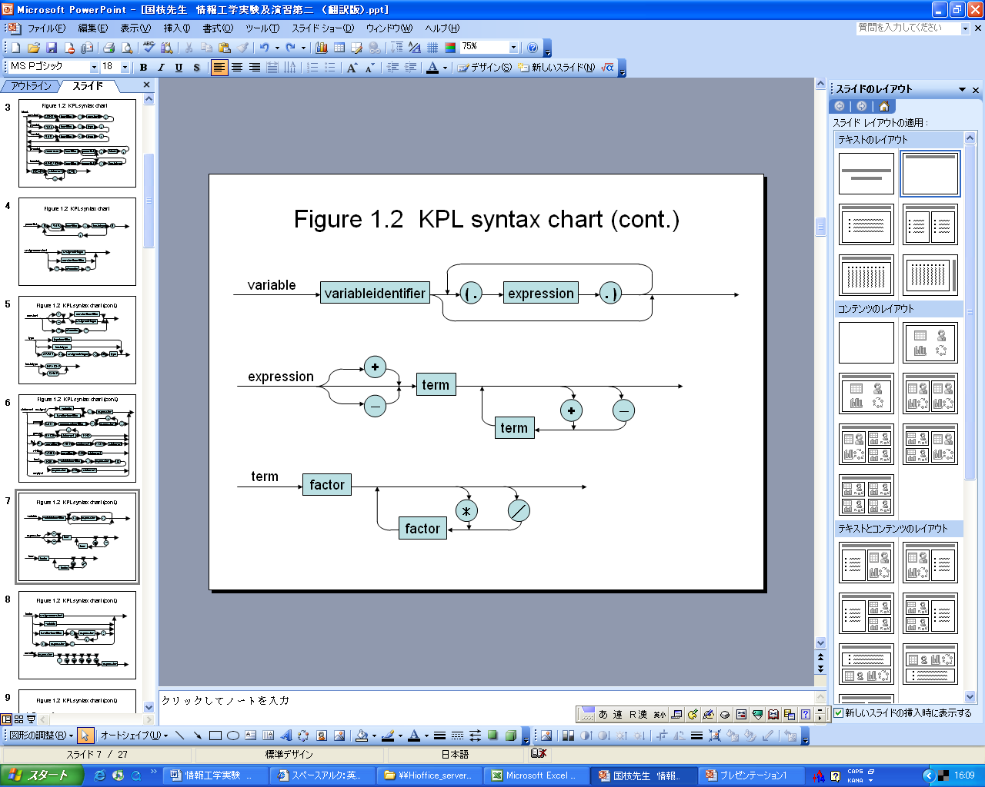
Syntax Diagrams of KPL (variable,expression,term)

Slide 24
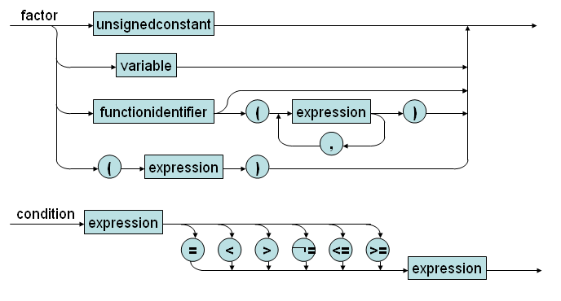
Syntax Diagrams of KPL (factor,condition)

Slide 25
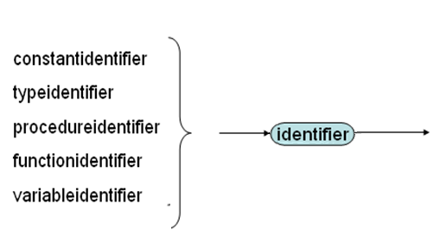
Syntax Diagrams of KPL (identifier,unsigned integer)

Slide 26
Exercise: a KPL program
Write a program that asks the user to type the value of an integer and compute its factorial.

Slide 27
Solution 1
program example1; (* Factorial *) var n : integer; i: integer; f:integer; BEGIN
n := readi;
f:=1; if n >=2
begin
for i:= 2 to n do
f:= f*i; call writeln; call writeI(f); end; END. (* Factorial *)

Slide 28
program example2; (* Factorial *) var n : integer; function f(k : integer) : integer; begin If k = 0 Then f := 1 Else f := k * f (k - 1); end; BEGIN n := readI; call writeln; call writeI(f(n)); END. (* Factorial *)
Solution 2 (using KPL functions)

